Slide 1
Linear interactions
Fecx = ax + by (positive interactions/mutualism)
Fecx = ax – by (negative interactions/antagonism)
a = intrinsic fitness coeff b = interaction coeff
a = 1, b = 0.5 (for all further simulations)

Slide 2
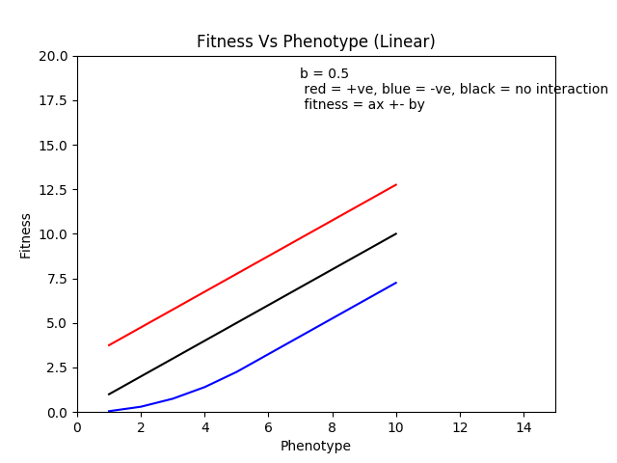
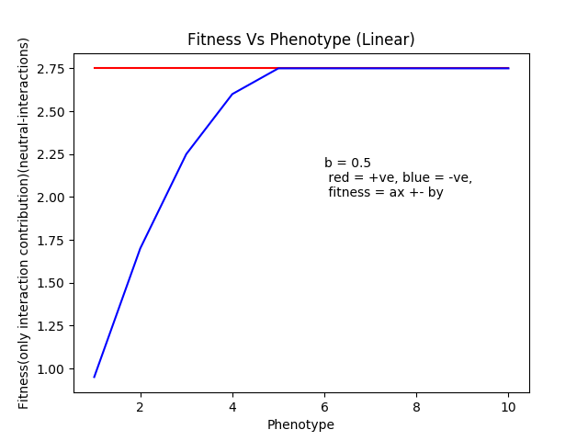

Slide 3
Parabolic fitness function
OU (Opening Up) fecx = (x – a)² + c, where a = 5.5 and c = 0.66
OD (Opening Down) fecx = -(x - a)² + c, where a = 5.5 and c = 21.25
Interaction term is of the same type eg. Fecx = -(x – a)² +c ± b(-(y – a)² + c)

Slide 4
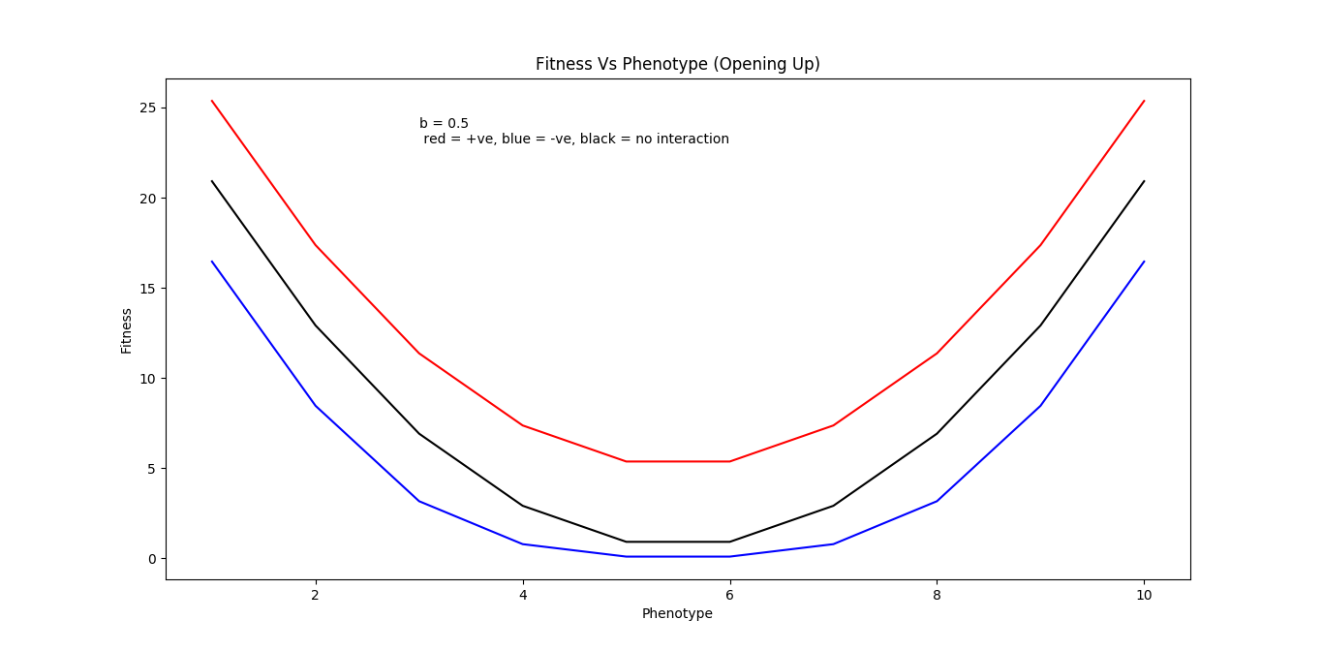
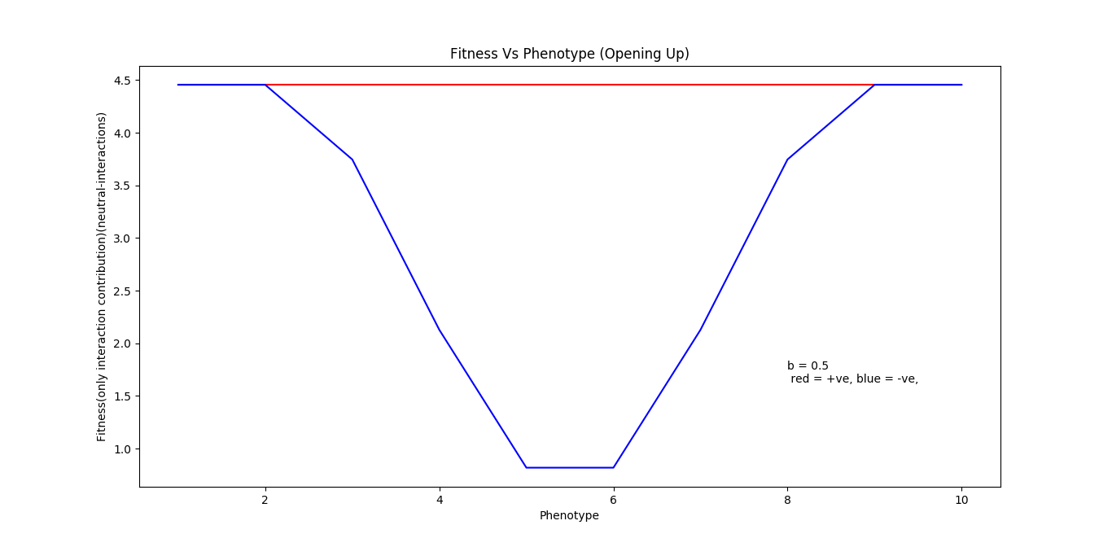

Slide 5
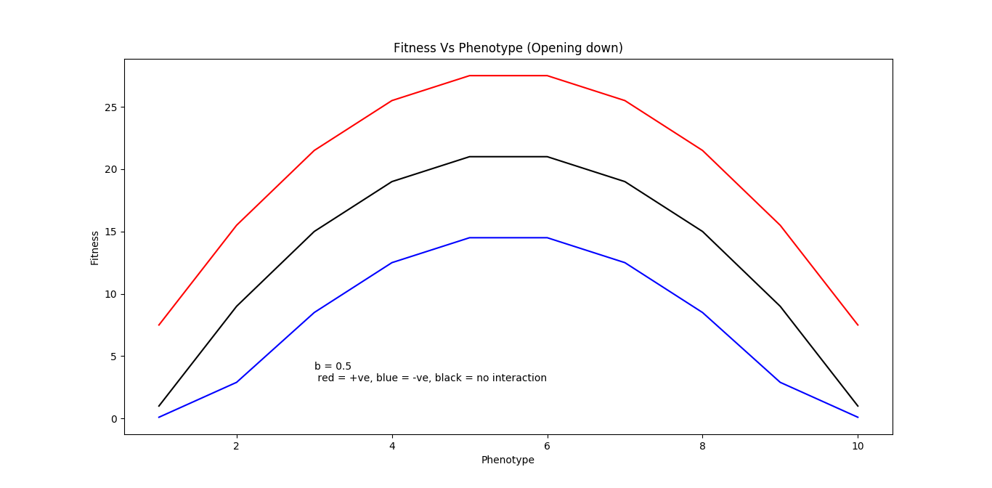
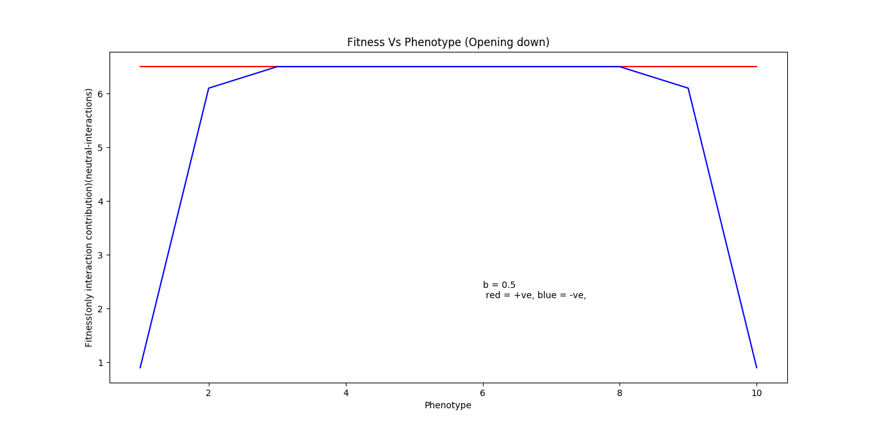

Slide 6
Saturating and opposite of it
OD (Opening Down) (Saturating) fecx = x*a*(1 – x/c), where a = 4 and c = 20.5
OU (Opening Up) (Opposite of saturating) fecx = (x – 1)*x*a + c, where a = 0.186 and c = 3.8
With interaction fitness eg. fecx = x*a*(1 – x/c) + b*(x*a*(1 – y/c))

Slide 7
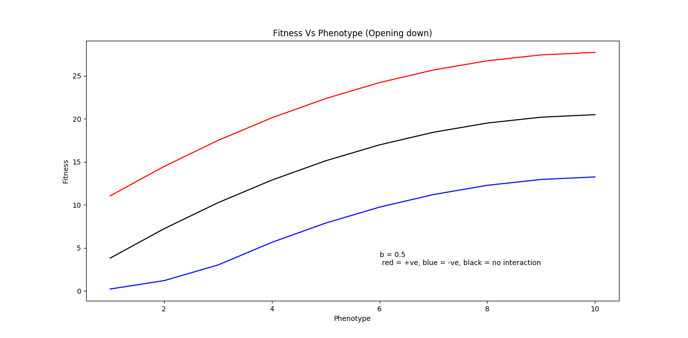
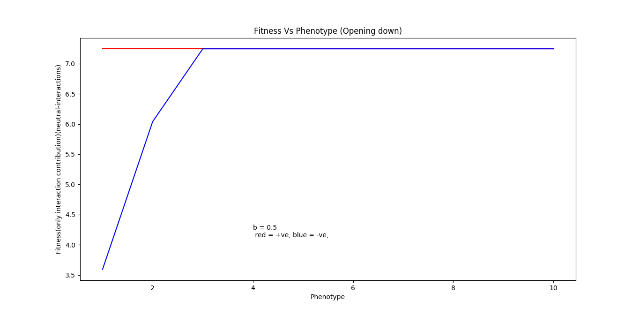

Slide 8
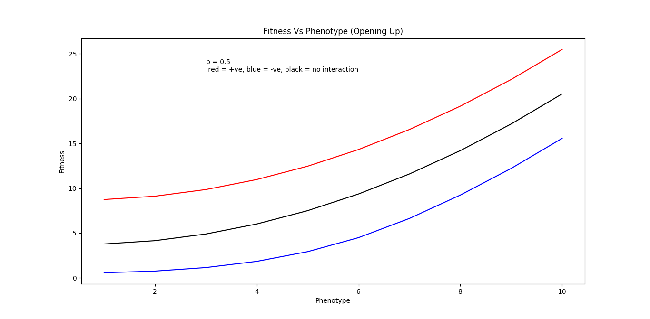
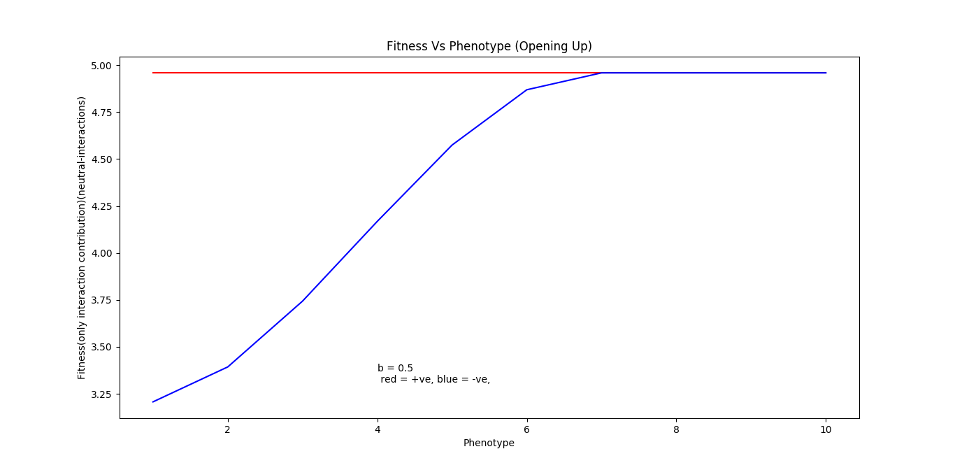

Slide 9
xy type interactions
X+y by xy type fecx = (x+y)/xy
Xy by x+y type fecx = xy/(x+y)
With interaction fitness eg. Fecx = (x+y)/xy + b*((y+x)/yx)

Slide 10
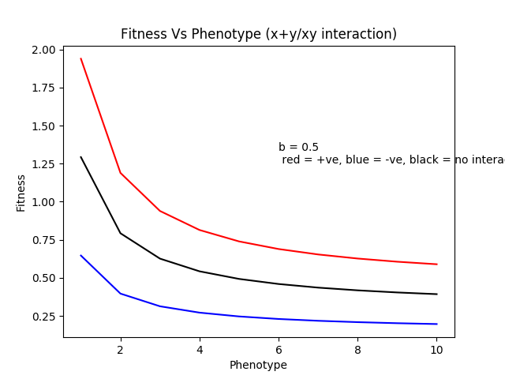
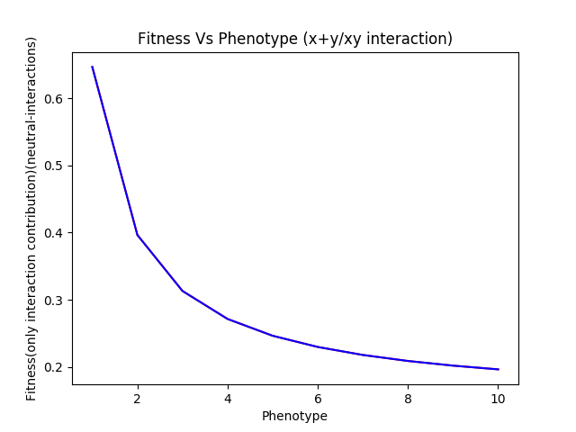

Slide 11
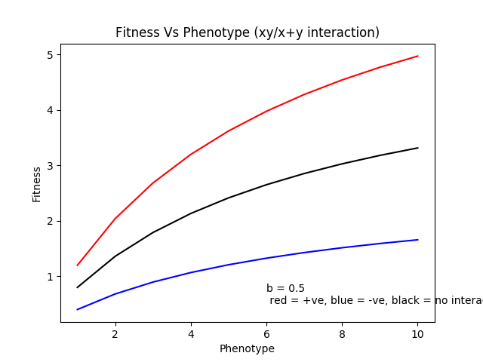
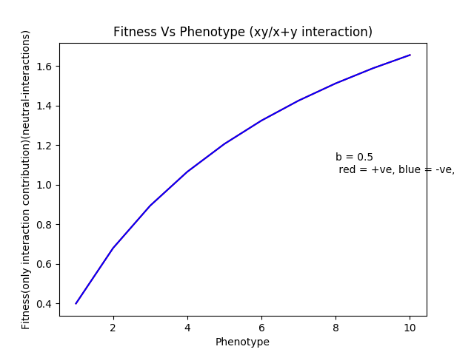

Slide 12
(x ± y)² type
fecx = a*(x – y)² ± b*(y – x)²
fecx = a*(x + y)² ± b*(y + x)² a = 1, b is 0.5 for normal simulations

Slide 13
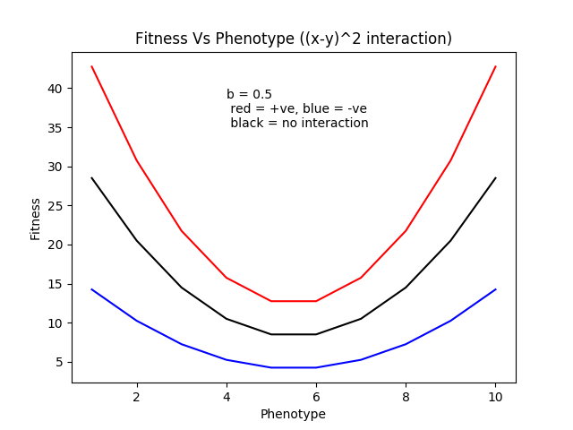
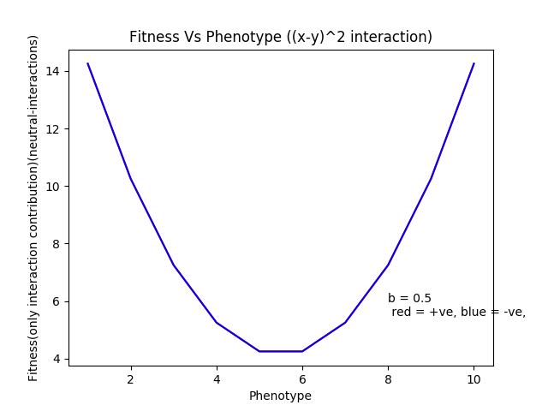

Slide 14
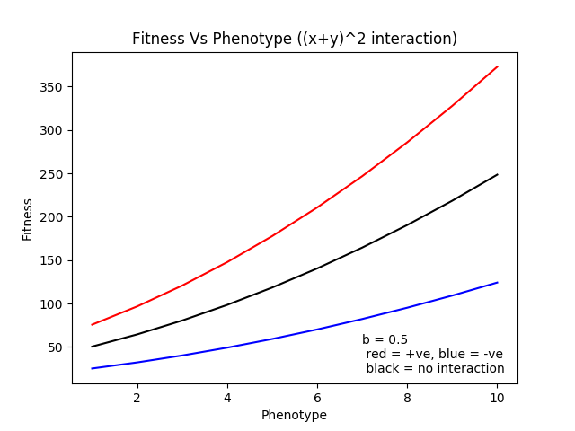
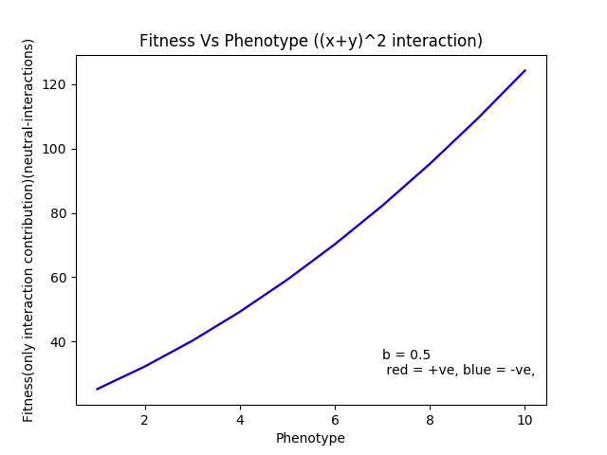

Slide 15
(x ± y)² interactions
Linear intrinsic, (x+y)^2 interactions e.g. fecx = a*x + b*(x+y)^2
Linear intrinsic, (x-y)^2 interactions e.g. fecx = a*x + b*(x-y)^2
(ax ± by)^2 type interactions Note: For no interactions in fitness vs phenotype graph (ax)^2 is used in this case.

Slide 16
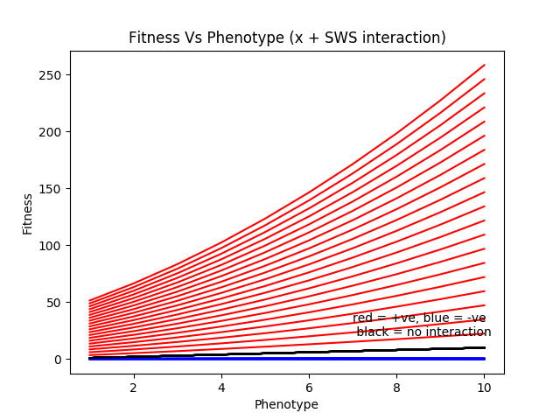
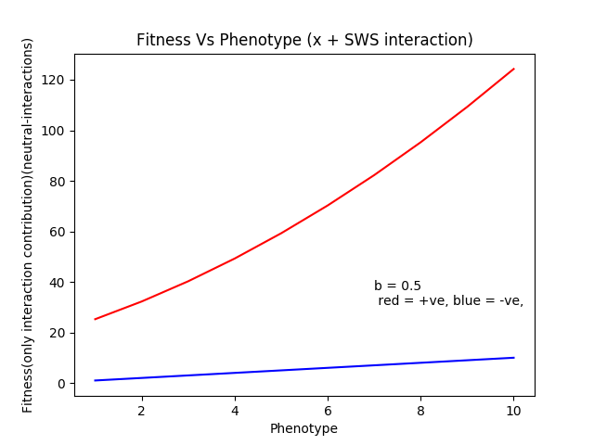

Slide 17
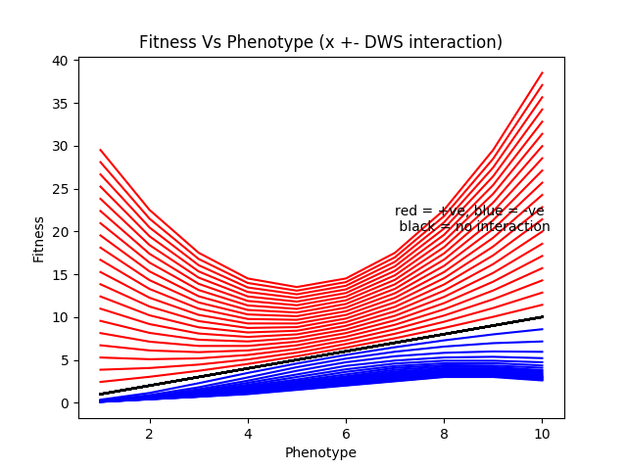
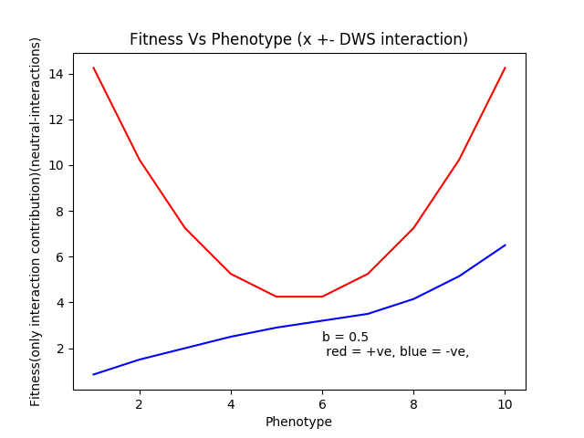

Slide 18
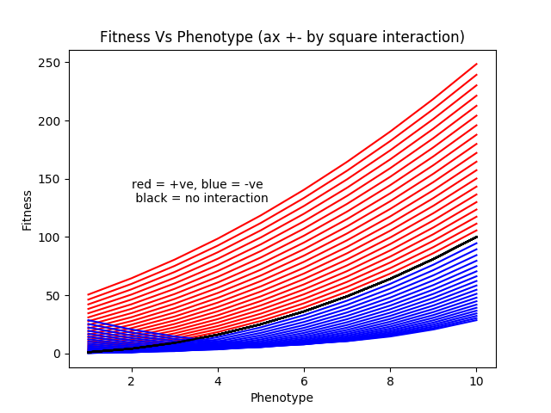
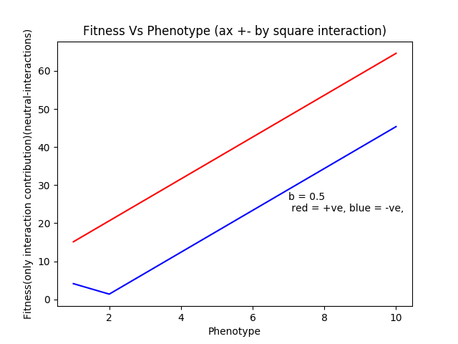

Slide 19
Whole square expanded
SWSE(Sum Whole square Expanded) fecx = a*x² + b*(2xy + y²) fecx = a*x² – b*(2xy + y²)
DWSE(Difference Whole Square Expanded) fecx = a*x² + b*(-2xy + y²) fecx = a*x² – b*(-2xy + y²)

Slide 20
